Slide 1
Presentation On:
Phishing Awareness
Presentation By: Aman Gupta
Presentation To: CodeAlpha

Slide 2

Introduction to Phishing
Definition: Phishing is a type of cyber-attack where attackers impersonate legitimate organizations or individuals to steal sensitive information, such as login credentials, financial information, or personal details.
Purpose: To deceive individuals into revealing sensitive information or installing malware.
Common Phishing Channels:
Email
SMS (Smishing)
Phone Calls (Vishing)
Social Media
Malicious Websites

Slide 3
Types of Phishing Attacks
Email Phishing: Characteristics of phishing emails (generic greetings, urgent language, suspicious links, and attachments).
Examples of common email phishing schemes (e.g., fake banking alerts, false job offers).
Spear Phishing: Targeted phishing attacks directed at specific individuals or organizations.
Examples of spear phishing in corporate environments.
Whaling: Phishing attacks aimed at high-profile targets like executives.
High stakes involved, often targeting sensitive corporate information.

Slide 4
Clone Phishing: Creating a near-identical copy of a legitimate email, replacing the attachment or link with a malicious one.
Website Phishing: Fake websites that mimic legitimate ones to steal credentials.
How to identify fake websites (e.g., URL manipulation, poor design, and spelling errors).
Social Engineering Tactics: Exploiting human psychology to gain trust and extract information.
Examples: pretexting, baiting, and tailgating

Slide 5
How to Recognize Phishing Attempts
Signs of a Phishing Email:
Suspicious sender addresses (e.g., slight misspellings).
Generic greetings like "Dear Customer."
Urgency and fear-inducing language.
Unsolicited attachments or links.
Requests for sensitive information (passwords, SSN).

Slide 6
Identifying Phishing Websites:
Check for HTTPS and the padlock symbol.
Hover over links to see the actual URL.
Look for subtle misspellings or extra characters in URLs.
Avoid clicking on pop-ups asking for login information.
Recognizing Social Engineering Attacks:
Unusual requests from co-workers or friends.
Pressure to bypass security procedures.
Calls or messages that ask for sensitive information unexpectedly.

Slide 7
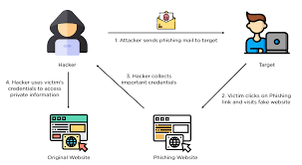
Consequences of Falling for Phishing Attacks
Data Breaches:
Exposure of sensitive information.
Financial losses.
Compromised accounts and identity theft.
Malware Installation:
Ransomware attacks.
Spyware stealing information over time.
Keyloggers capturing every keystroke.
Organizational Impact:
Financial damage.
Loss of reputation and customer trust.
Legal consequences and regulatory fines.

Slide 8
Best Practices to Avoid Phishing Attacks
Email Security:
Don’t click on suspicious links or attachments.
Verify the sender’s identity through other means (e.g., phone call).
Report phishing emails to your IT department.
Website Security:
Type URLs directly into your browser instead of clicking links in emails.
Use bookmarks for frequently visited sites.
Install anti-phishing browser extensions.

Slide 9
General Security Measures:
Keep software and antivirus programs up to date.
Use multi-factor authentication (MFA) wherever possible.
Regularly update and strengthen passwords.
Organizational Policies:
Regular phishing simulation tests.
Mandatory cybersecurity training.
Incident response plan for phishing attacks.

Slide 10
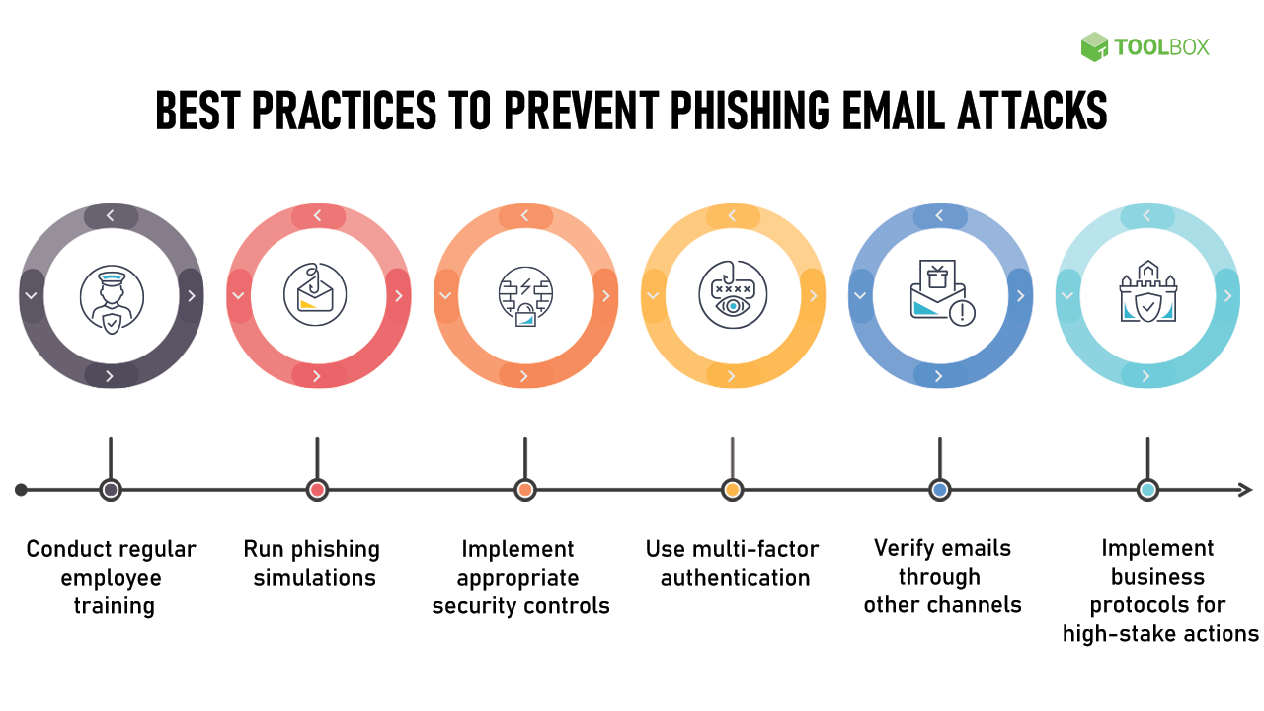

Slide 11
Case Studies & Examples
LoveLetter Attack:
Love Letter Attack was perform in year 2000 by Onel De Guzman. He develop malicious code for stilling internet user login data. In this attack user receive a email with subject line “ I Love You” and label attach contain “Love Letter for You”. When user open attachment, malicious code installed and then malware scanned user address book. Then it automatically sent itself to each person on list and install a program to collect user information and passwords and recipient think this email is send by my friend.
At the end this infecting 45 million computer Globally and make $10 billion dollar loss.

Slide 12
Thank You
Contact:
Gmail- kuchiyaaman12@gmail.com
Mob No. - 9630207064

